Slide 1

Server Side Programing

Slide 2
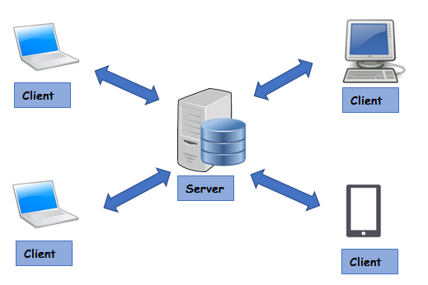
What is server side programing?

Slide 3
Different Type of Languages
PHP
Python
C#
C+
NodeJS
Ruby
JavaSript

Slide 4
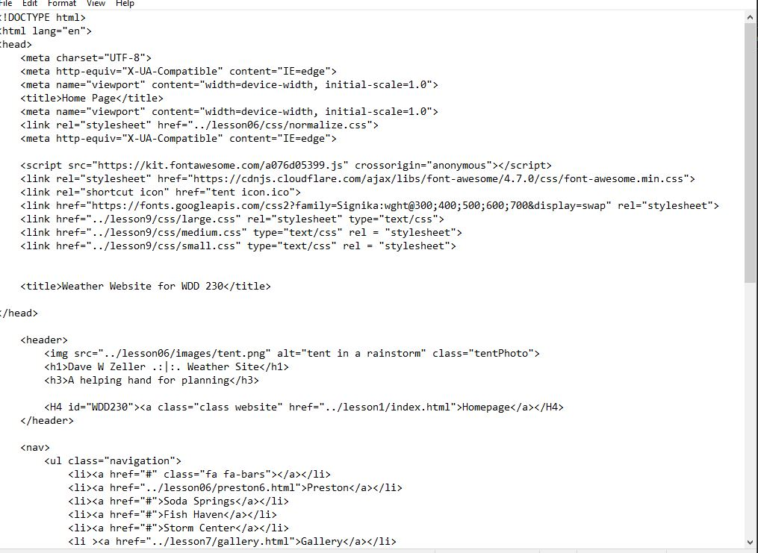
Html links request information

Slide 5
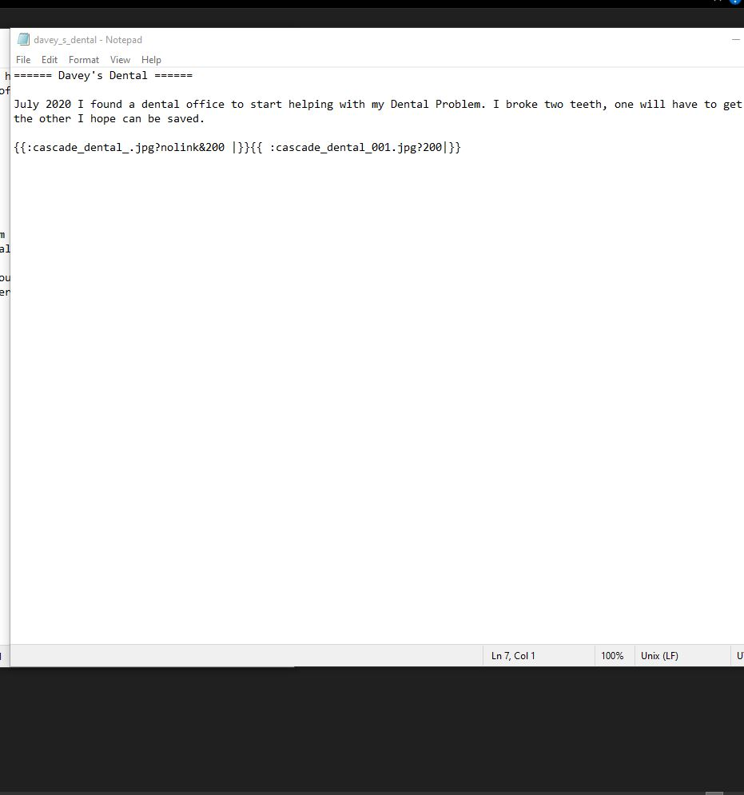
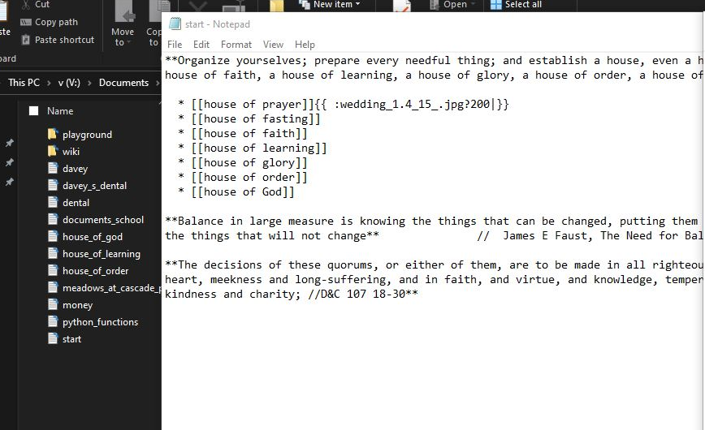


The Server Program Request

Slide 6
The Server Program Sends The Info Back

